Slide 1

7 Foundational Ad Types

Slide 2
01
How did we discover this?

Slide 3
How did we discover this?
We realized that we had $80M in spend to represent an incredibly data-rich set of insights.
5K+
In ads / variations
15+
Industries
$80M
In ad spend
6+
Years

Slide 4
02
What are the 7 foundational ads?

Slide 5
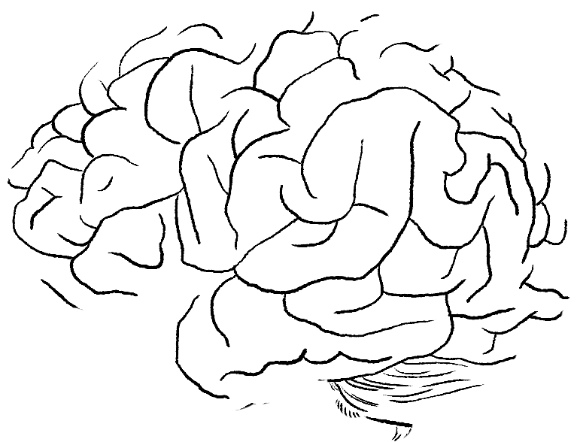
THE 7 FOUNDATIONAL AD CATEGORIES
We’ve broken down 100 different ad types into 7 foundational categories of ads
that have proven to be the highest performing.
04
UGC
03
Real users showcasing and reviewing the product or service experience
Social Proof
05
Opinions of brand or product by consumers, influencers, news sites, blogs, etc… Leveraged to create trust between consumer and brand.
Case Study / Evidence
Demonstrable study or testing of product proving superior performance or increased quality of life.
02
06
Lifestyle
Product Hero
Highlights the product features and demonstrates the value points to consumer
Aspirational content that shows the product being used in everyday life.
01
07
Closer Ads
Spokesperson
Highly engaging video featuring a person explaining the product and highlighting its features.
Resolve customer concerns, dynamically display, or offer promos and finalize the sale.

Slide 6
The 7 Foundational Ads
Examples
Lifestyle - Skytech
Product Demo - EarthBreeze
Unboxing - Pip Lancets
Case Study (Evidence) - Slingshot
Closer - FrostNYC
Spokesperson - Fabletics
Social Proof - Direct Colors

Slide 7
LET’S BLOW UP THE INTERNET TOGETHER.

